Slide 1

Final Review-Sem 1
Group-12
Done By-
Atharva Ostwal
Yashshree Kirad
Atharva Pawar
Suyog Karpe
Project Guide-
Prof.B.C.Julme

Slide 2
ConnectCraft
Simplifying Network Choices

Slide 3
Motivation:
At the heart of "ConnectCraft" lies our unwavering commitment to empowering you, the user. We understand that connectivity is not a one-size-fits-all concept. It's about having the freedom to choose the network provider that seamlessly integrates into your lifestyle and meets your unique demands.
Our motivation is simple yet profound: we want to ensure user never tethered to a network that doesn't meet needs. With "ConnectCraft," you're not just searching for a network; you're embarking on a journey toward a more connected, productive, and satisfying digital experience.

Slide 4
Problem Statement:
Develop an AI powered system leveraging historical and real-time data for accurate prediction of location based network performance,This solution will empower users to make informed decisions when selecting service providers,ensuring seamless connectivity and optimal performance for their specific geographical needs.

Slide 5
Objectives:
Accurate Network Performance Prediction
Real-time Data Integration
Historical Data Utilization
User Empowerment
Transparency and Informed Decision-Making
Enhanced User Experience
Choice and Provider Selection
Service Provider Accountability
Feedback Loop
Data Privacy and Security
Scalability
Continuous Improvement

Slide 6
Scope :
Functionality
Data Management
User Experience
Service Providers
Security & Privacy
Scalability
Monitoring & Maintenance
Ethical Compliance
Cost & Budgeting
Feedback & Improvement
Documentation & Training
Business Strategy
Geographic Expansion
Tech Stack
Project Timeline
Market Analysis

Slide 7
Literature Review:
Existing systems -
Cisco DNA Center:
An AI-powered network analytics and assurance platform with robust monitoring and troubleshooting capabilities, ideal for large-scale networks but may have higher associated costs. Cons include cost barriers for smaller networks and a potentially steep learning curve due to its advanced features.
Aruba Central:
AI-driven network monitoring with real-time visibility for optimized performance. However, cons include hardware dependency, which may affect cost and limit adoption for organizations with existing infrastructure commitments.

Slide 8
Existing systems -
Nokia AVA AI:
A robust network analytics platform for service providers and large enterprises, optimizing network performance and resource allocation. However, its focus on large-scale networks may limit its cost-effectiveness for smaller organizations.
NetScout nGeniusONE:
Provides real-time network visibility and detailed performance analysis. However, cons include the need for additional hardware, potentially increasing costs and complexity, which may not be suitable for all organizations

Slide 9
Related papers -
1.NETWORK STRENGTH COMPARISON BY REGION -
The research paper, "Network Strength Comparison by Region," delves into network comparisons and security measures. It underscores Reliance Jio's remarkable 20.8 Mbps 4G speed, outperforming competitors, including Airtel. Despite Airtel's faster network, Jio secures a majority of subscriptions, largely attributed to its cost-effective data plans with extended validity. The study reveals the substantial influence of pricing on network preferences in India. This analysis aids in understanding the intricate dynamics of the Indian telecom market, where network speed and affordability are pivotal factors for user choices.
2. Comparing Broadband ISP Performance using Big Data from M-Lab -
"Network Strength Comparison by Region" explores network comparisons and security. It showcases Reliance Jio's impressive 20.8 Mbps 4G speed, although Airtel offers a faster network. The paper underscores pricing's critical role in India's network preferences and the growing importance of robust security measures in an increasingly network-dependent landscape.

Slide 10
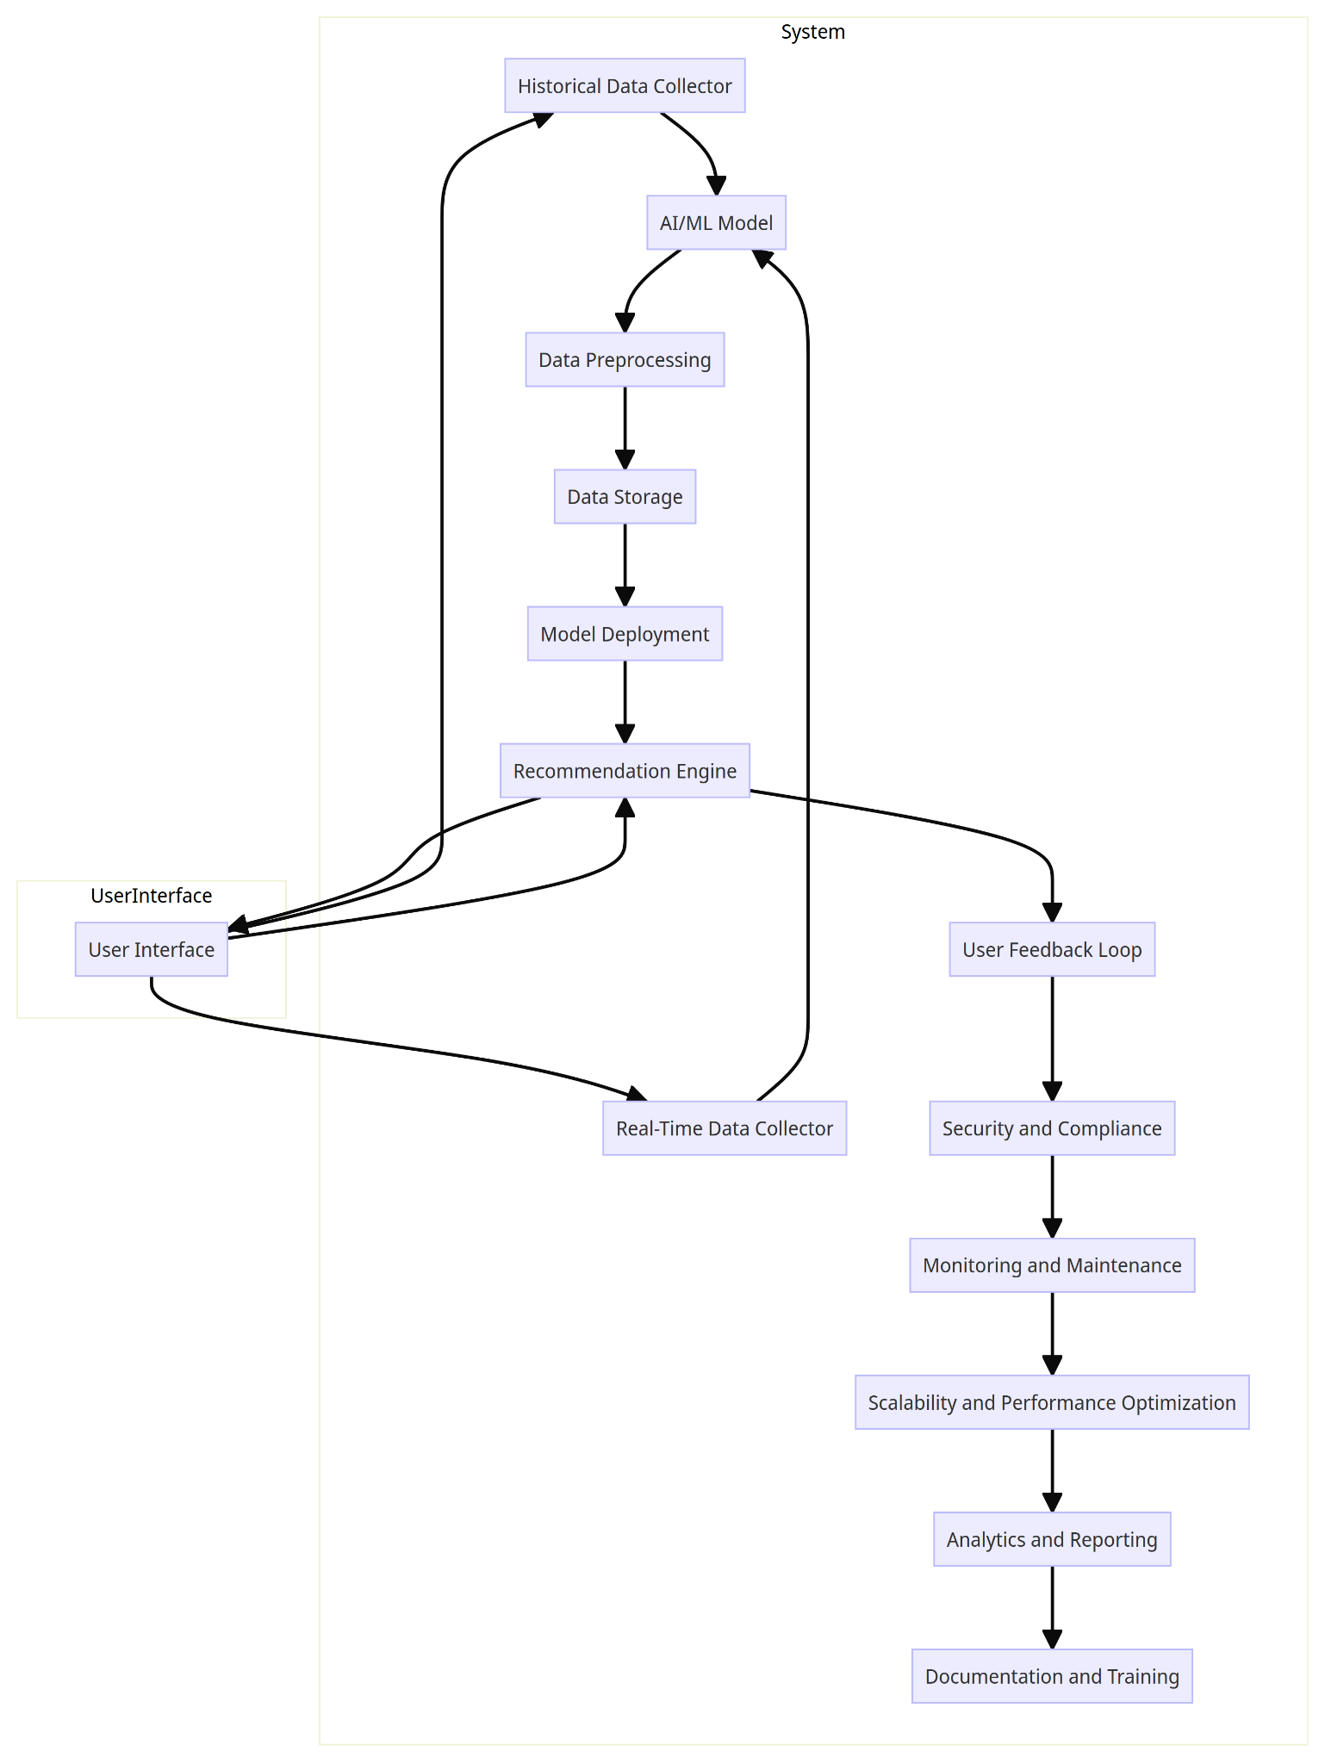
Architecture Diagram:

Slide 11
Software Requirements:
Operating System: Robust and secure; Linux-based distributions (e.g., Ubuntu, Windows) are preferred for server-side components.
Database Management System: Needed for data storage; options include MySQL, or NoSQL databases like MongoDB.
Programming Languages: Python (AI and ML), JavaScript/HTML/CSS (UI), Java or C++ (backend).
AI and ML Frameworks: Utilize TensorFlow, PyTorch, or scikit-learn for model development.
Web Development Frameworks: Use Django or Flask for UI and RESTful APIs.
Containerization and Orchestration: Tools for scalable service management.
Data Visualization: Libraries like Matplotlib, D3.js, or Plotly for presenting data.
Security and Compliance Tools: Implement security and compliance frameworks for data protection.

Slide 12
Hardware Requirements:
Server Infrastructure: Cloud-based (AWS, Azure, GCP) for scalability.
Storage: High-capacity storage, including SSDs or cloud solutions.
GPUs: NVIDIA GPUs for ML model training.
Networking: High-speed and reliable infrastructure.
Redundancy and Failover: Ensure high availability and fault tolerance.
Security Hardware: Firewalls, intrusion detection, hardware security modules.
Scalability: Design for future growth in data and user load

Slide 13
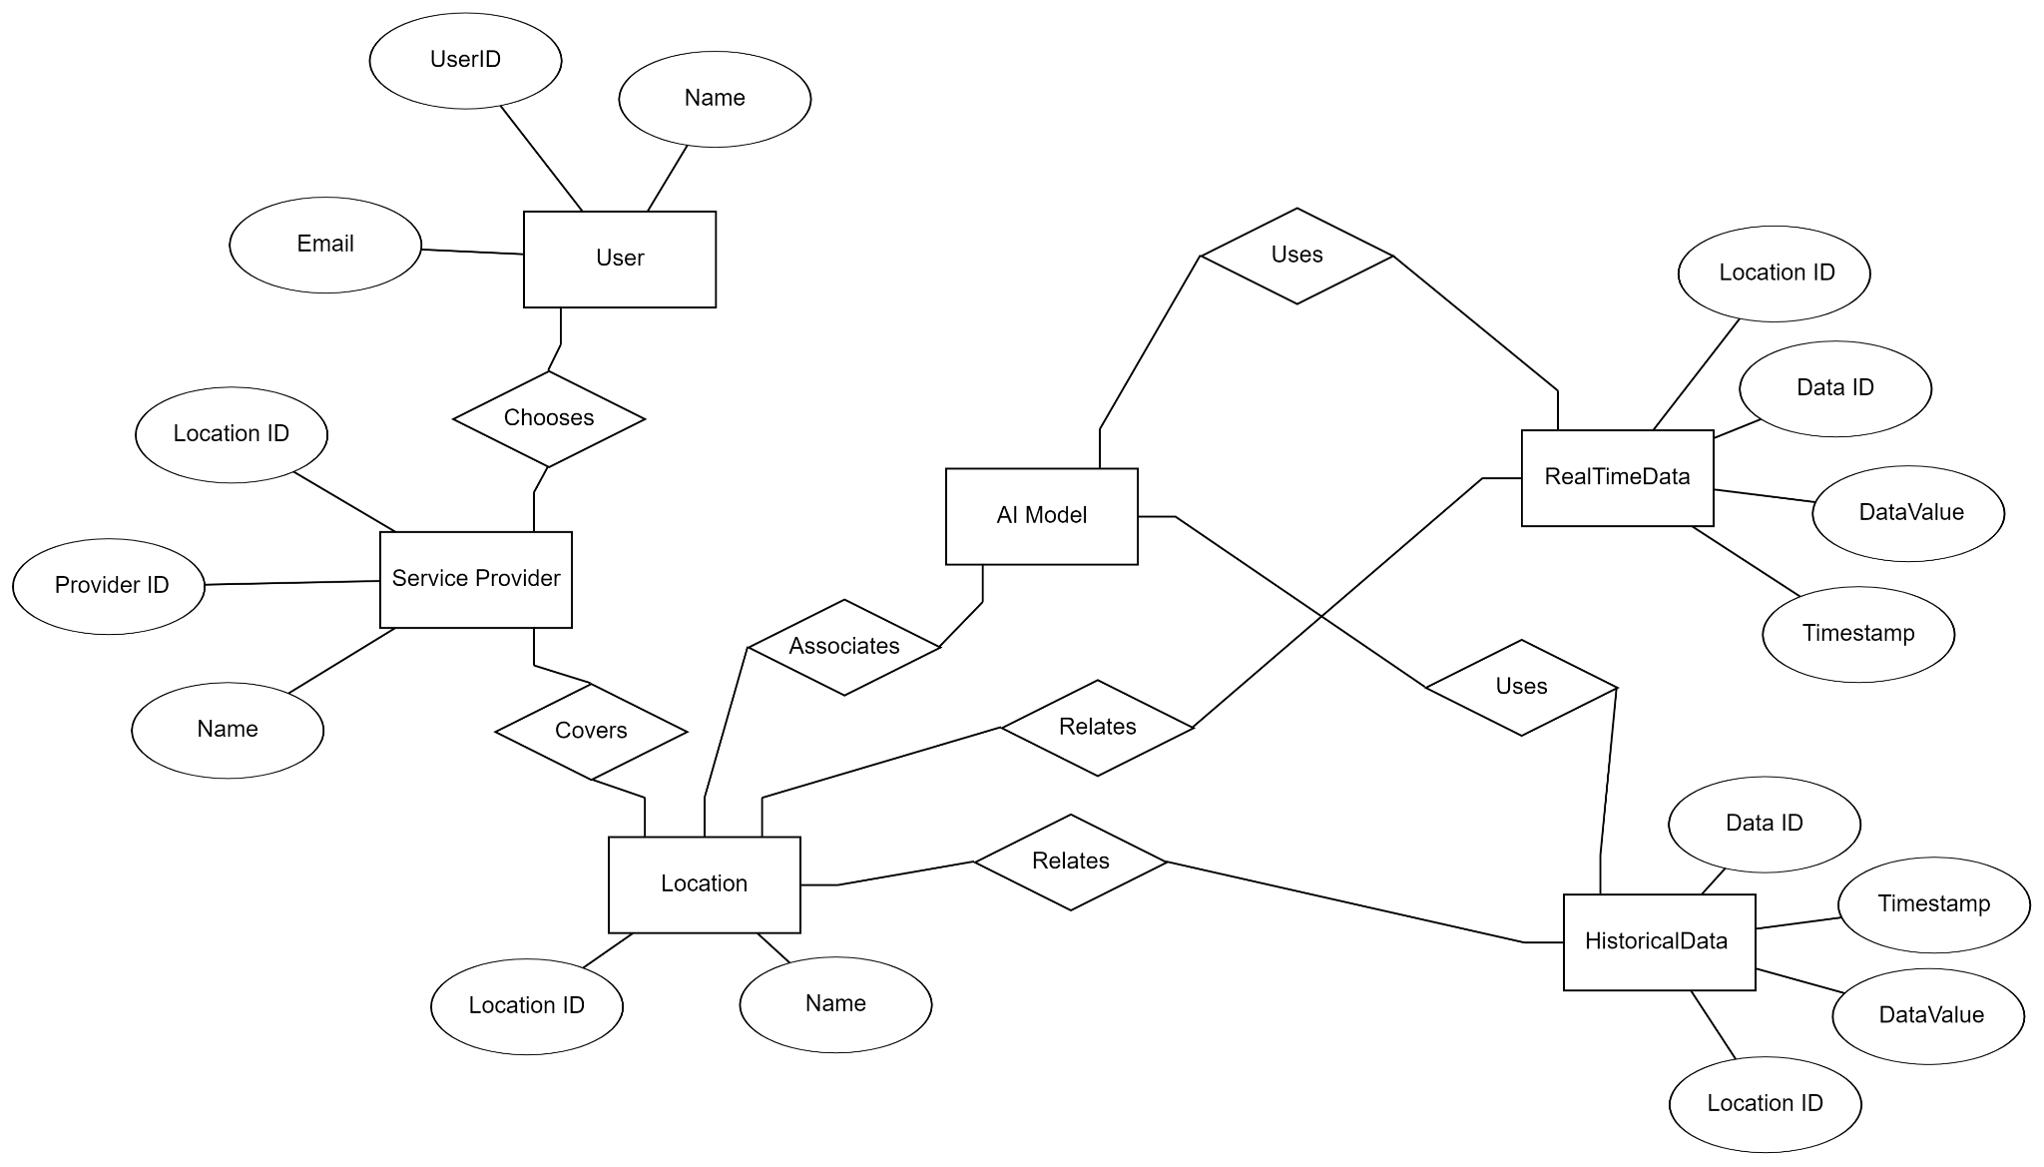
Design -
Entity Relation Diagram

Slide 14
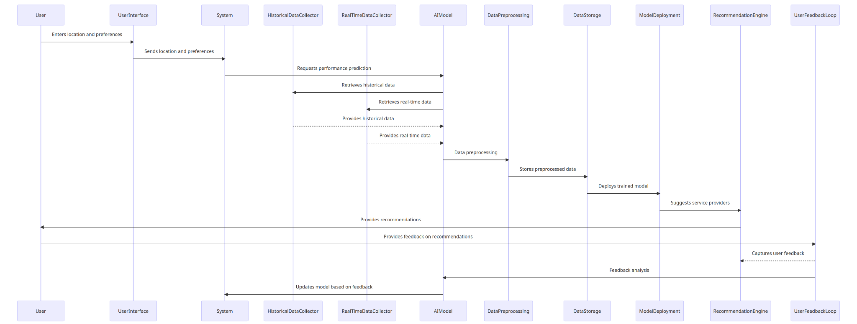
Sequence Diagram

Slide 15
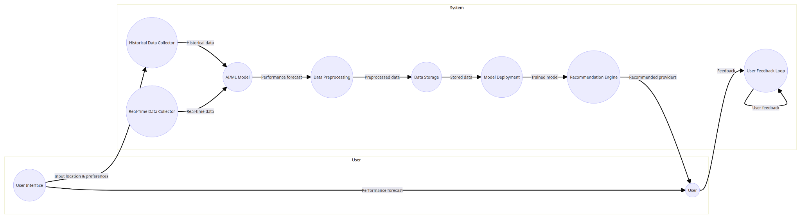
Data Flow Diagram

Slide 16
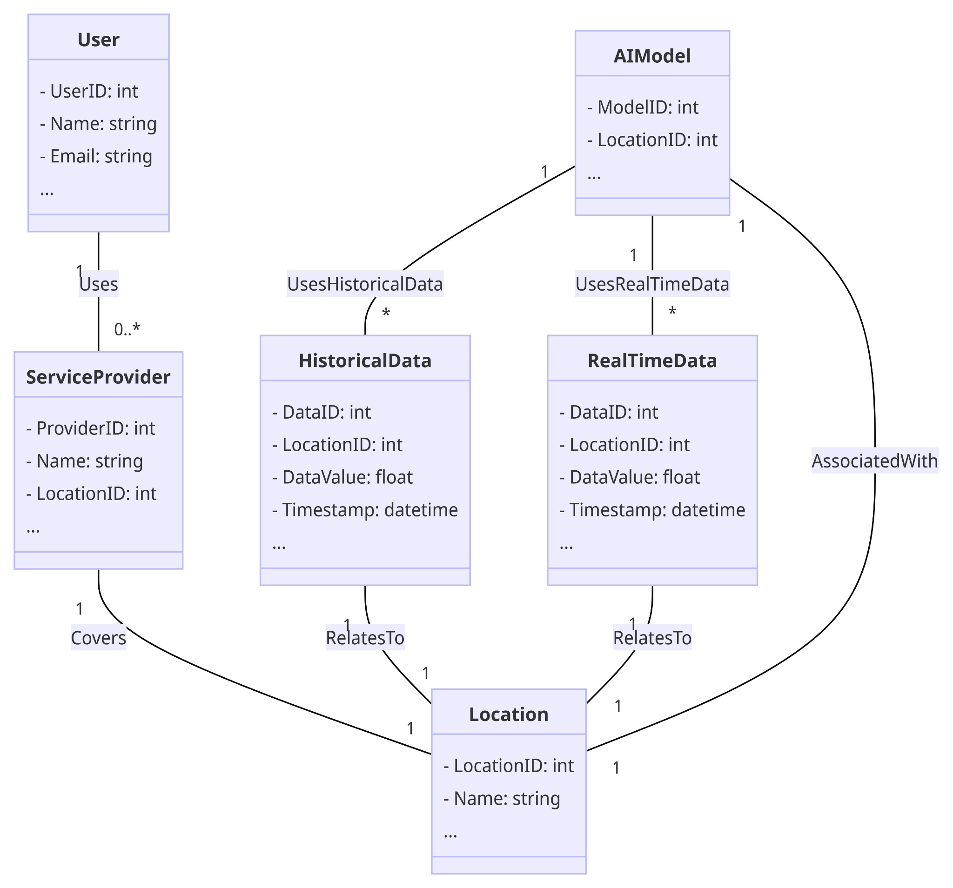
Class Diagram

Slide 17
Modules and Functionality:
Data Ingestion and Collection:
Functionality: Gathers historical and real-time network performance data for analysis.
Components: Historical and Real-Time Data Collectors.
Data Preprocessing:
Functionality: Cleans, normalizes, and prepares collected data for analysis.
Components: Data Cleaning and Normalization.
Data Storage:
Functionality: Stores preprocessed historical and real-time data for retrieval.
Components: Historical Data Warehouse and Real-Time Data Storage.
AI/ML Model Development:
Functionality: Develops and fine-tunes machine learning models for network performance prediction.
Components: Model Training and Evaluation.

Slide 18
Model Deployment:
Functionality: Deploys trained models as APIs or services for user access.
Components: Model APIs.
User Interface:
Functionality: Provides user input interfaces for location selection and displays network performance predictions.
Components: Location Input Interface and Prediction Display Interface.
Provider Information Integration:
Functionality: Integrates information about service providers, including coverage areas, pricing, and quality data.
Components: Provider Information Database/API
Recommendation Engine:
Functionality: Suggests service providers based on predictions and user preferences.
Components: Recommendation Algorithms.
User Feedback Loop:
Functionality: Captures and analyzes user feedback on recommended providers and network performance.
Components: Feedback Collection and Analysis.

Slide 19
Monitoring and Maintenance:
Functionality: Monitors system health, AI model performance, and data sources. Regularly updates AI models.
Components: Monitoring Dashboards and Model Update Scheduler.
Scalability and Performance Optimization:
Functionality: Ensures the system can scale horizontally and optimizes real-time data processing and predictions.
Components: Scalability Framework and Performance Optimization Algorithms.
Analytics and Reporting:
Functionality: Provides analytics and reporting capabilities for users and administrators.
Components: Reporting Tools and Analytics Engine.
Documentation and Training:
Functionality: Documents system architecture and processes, and provides training materials for administrators and users.
Components: Documentation Repository and Training Materials.

Slide 20

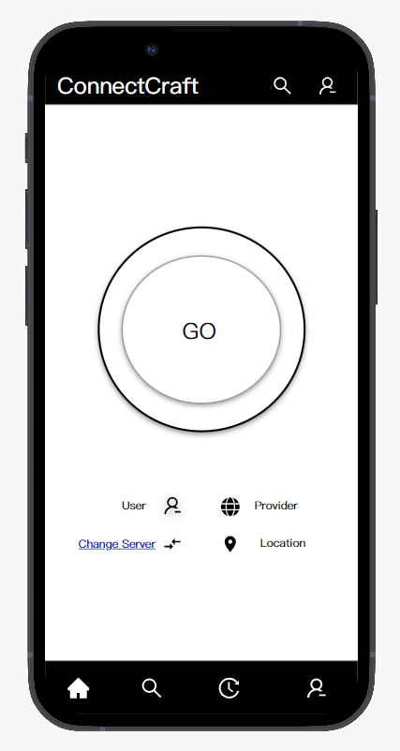

Prototypes:

Slide 21
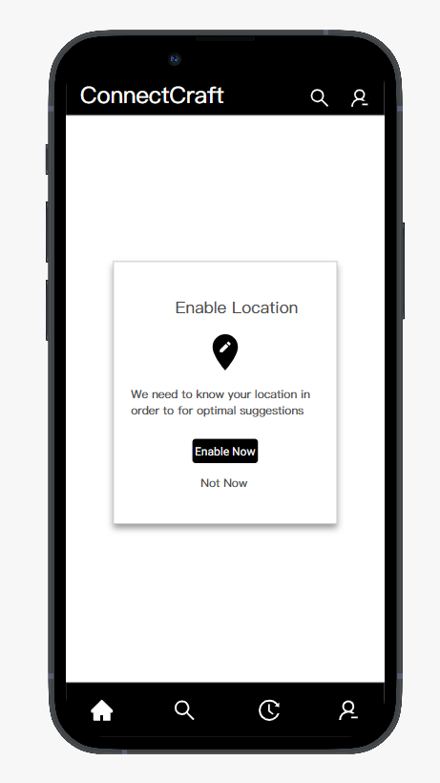
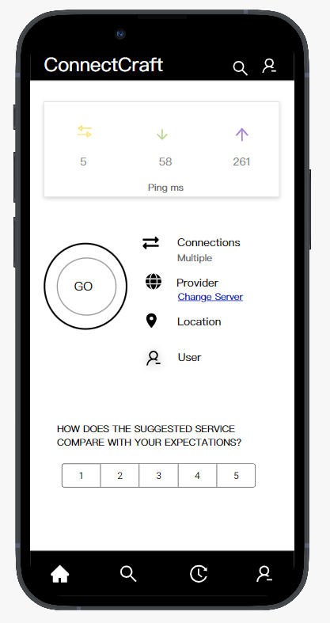

Slide 22
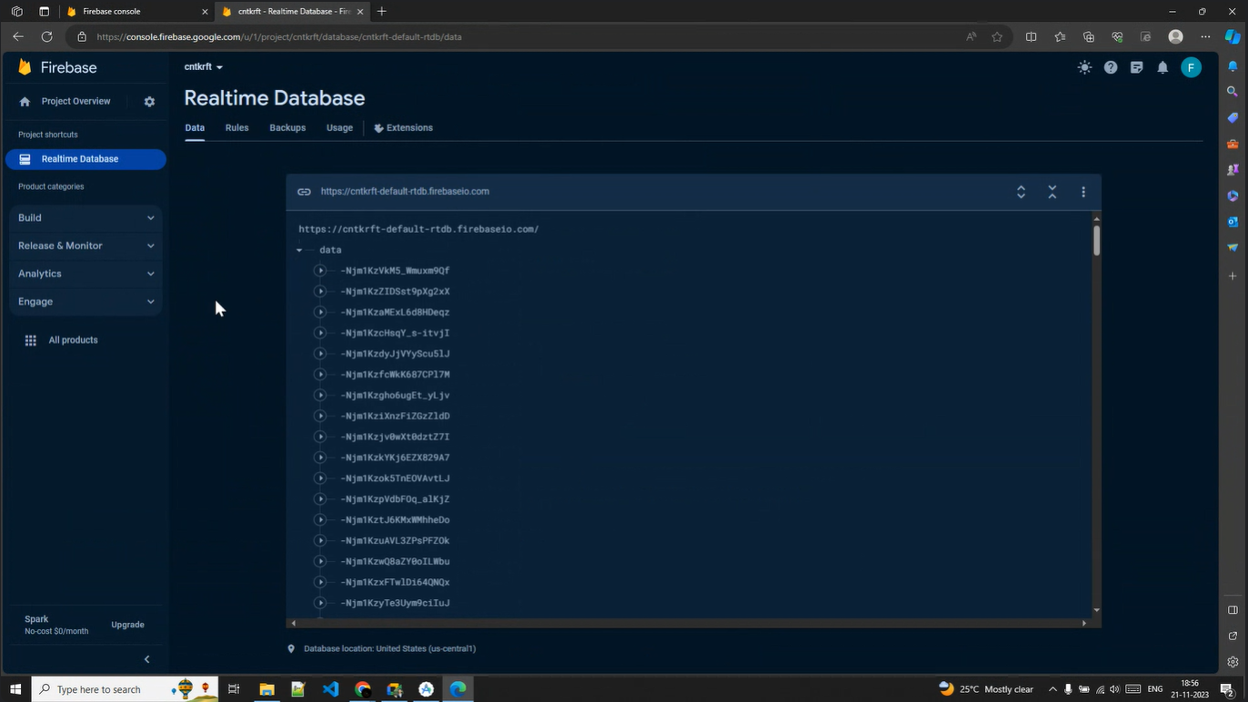
Live Database Recorded

Slide 23
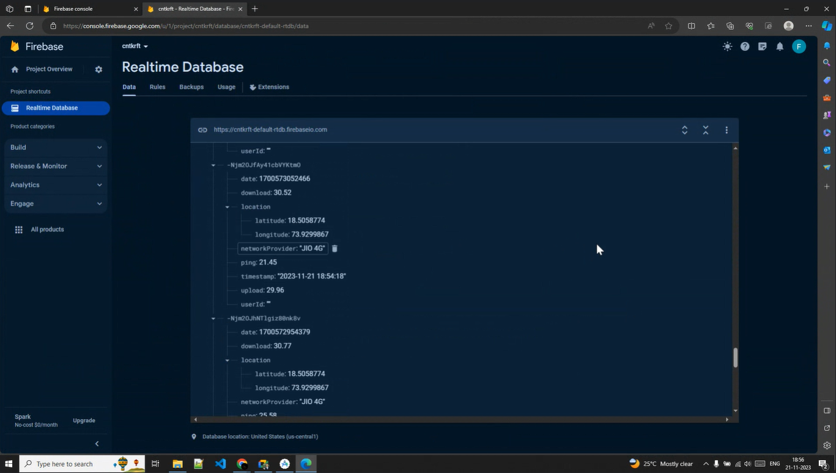
Live Database Detailed

Slide 24
Conclusion:
In conclusion, we have delved into the intricate dynamics of network strength comparison and security in the context of modern telecommunications. Our findings underscored the significance of affordability, reliability, and speed as primary factors influencing user preferences in network selection.
Furthermore, the crucial role of robust security measures and data compliance in safeguarding user data and network integrity cannot be overstated. As we navigate an ever-evolving landscape of network technologies, it contributes to a deeper understanding of network performance and user behavior, offering practical recommendations for service providers, users, and policymakers alike.

Slide 25
Thank-You!

